Slide 1
STAT3007: Introduction to Stochastic Processes
Markov Chains – Introduction
Dr John Wright

Slide 2
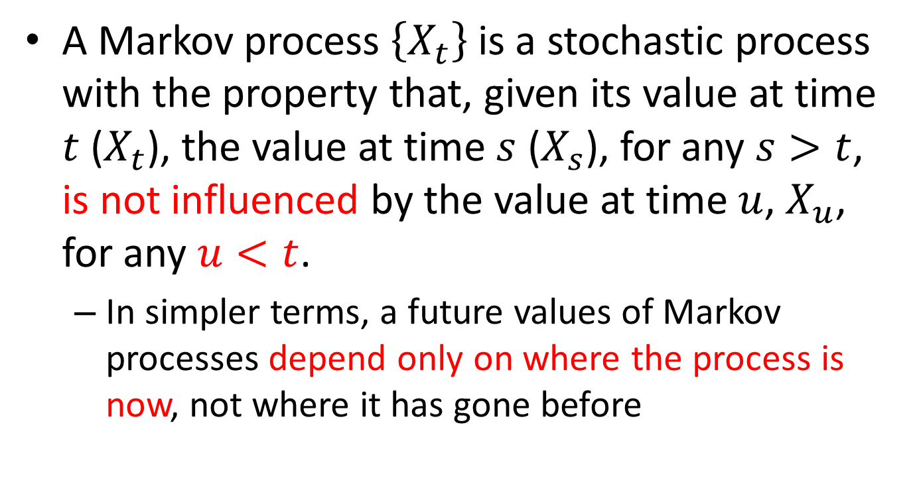
Markov Process
A Markov process $\left\{X_{t}\right\}$ is a stochastic process with the property that, given its value at time $t$ ($X_{t}$), the value at time $s$ ($X_{s}$), for any $s>t$, is not influenced by the value at time $u$, $X_{u}$, for any $u<t$.
In simpler terms, a future values of Markov processes depend only on where the process is now, not where it has gone before

Slide 3
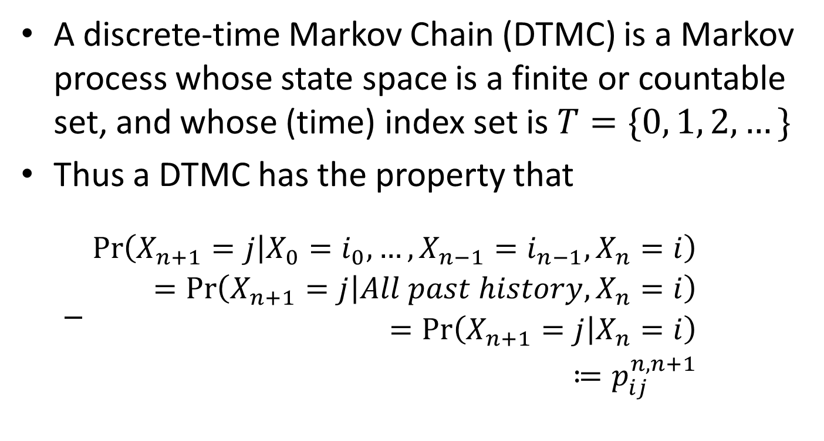
Discrete-time Markov Chain
A discrete-time Markov Chain (DTMC) is a Markov process whose state space is a finite or countable set, and whose (time) index set is $T=\{0, 1, 2, …\}$
Thus a DTMC has the property that
$\begin{aligned}\operatorname{Pr}\left(X_{n+1}=j | X_{0}=i_{0},…,X_{n−1}=i_{n−1},X_{n}=i\right)& \\ =\operatorname{Pr}\left(X_{n+1}=j | All past history, X_{n}=i\right)& \\ =\operatorname{Pr}\left(X_{n+1}=j | X_{n}=i\right)& \\ ≔p_{ij}^{n,n+1}& \end{aligned}$

Slide 4
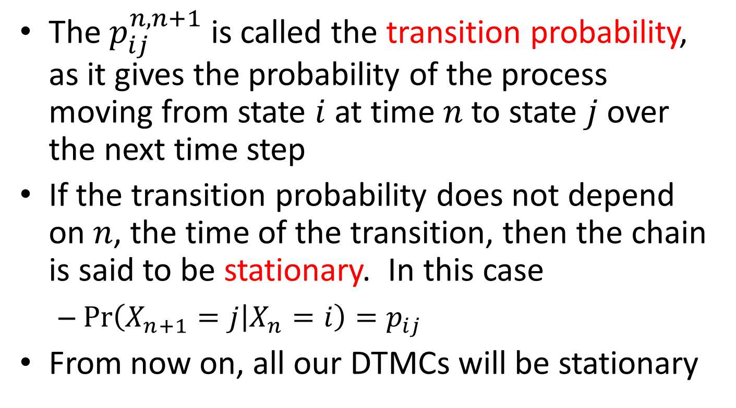
Stationary Markov Chain
The $p_{ij}^{n,n+1}$ is called the transition probability, as it gives the probability of the process moving from state $i$ at time $n$ to state $j$ over the next time step
If the transition probability does not depend on $n$, the time of the transition, then the chain is said to be stationary. In this case
$\operatorname{Pr}\left(X_{n+1}=j | X_{n}=i\right)=p_{ij}$
From now on, all our DTMCs will be stationary

Slide 5
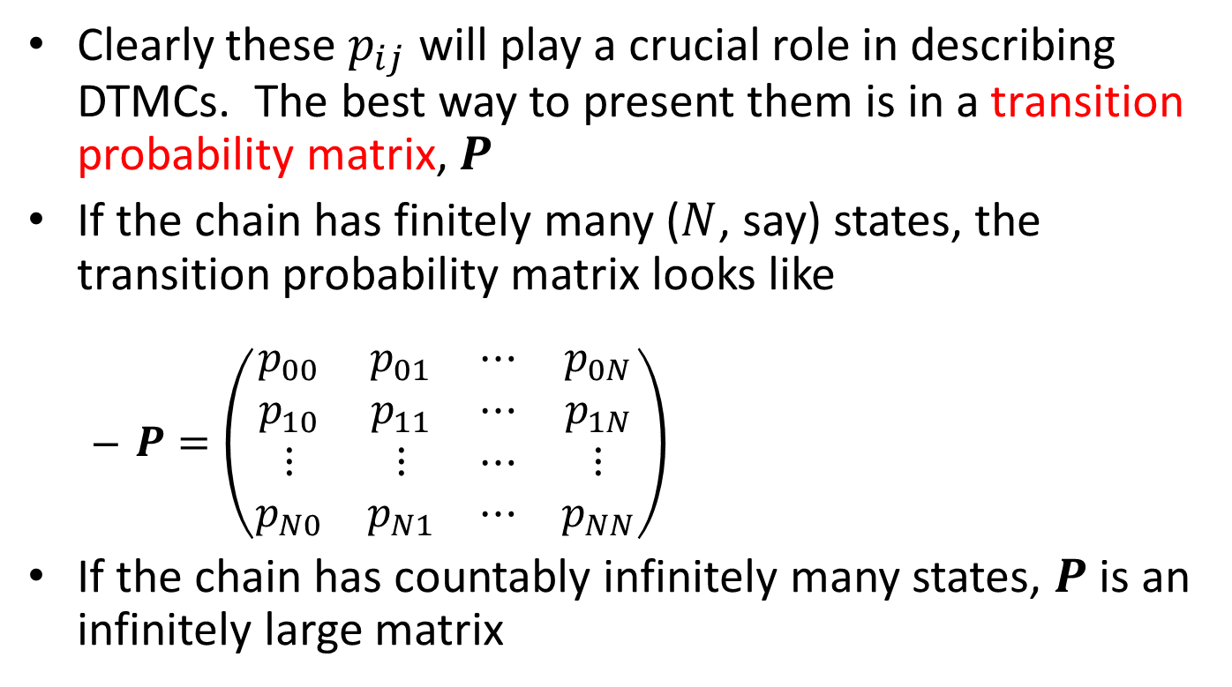
Transition Probability Matrix
Clearly these $p_{ij}$ will play a crucial role in describing DTMCs. The best way to present them is in a transition probability matrix, $P$
If the chain has finitely many ($N$, say) states, the transition probability matrix looks like
$P=\left(\begin{matrix}p_{00} & p_{01} & ⋯ & p_{0N} \\ p_{10} & p_{11} & ⋯ & p_{1N} \\ ⋮ & ⋮ & ⋯ & ⋮ \\ p_{N0} & p_{N1} & ⋯ & p_{NN}\end{matrix}\right)$
If the chain has countably infinitely many states, $P$ is an infinitely large matrix

Slide 6
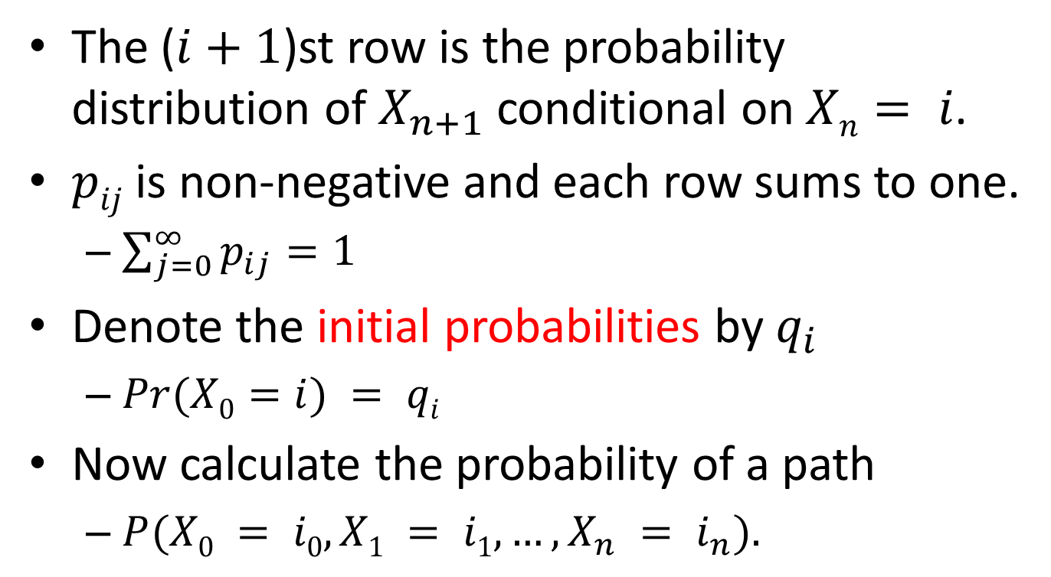
Markov matrix
The ($i+1$)st row is the probability distribution of $X_{n+1}$ conditional on $Xn= i$.
$pij$ is non-negative and each row sums to one.
$\sum_{j=0}^{∞}{p_{ij}}=1$
Denote the initial probabilities by $q_{i}$
$Pr(X0=i) = qi$
Now calculate the probability of a path
$P(X0 = i0, X1 = i1, …, X_{n} = i_{n}).$

Slide 7
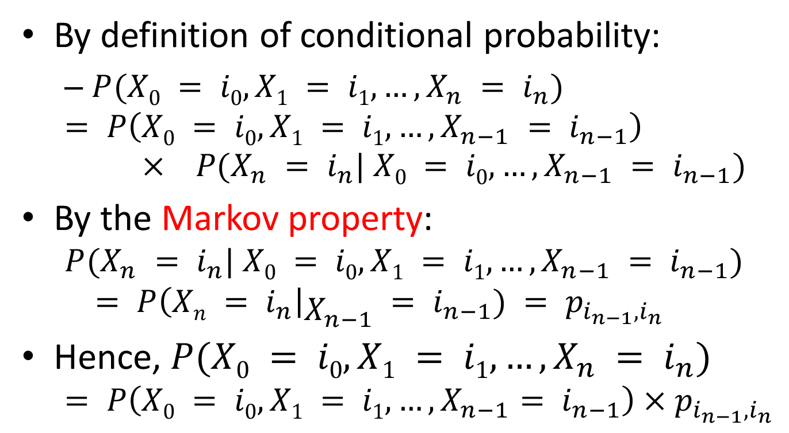
Characterising a Markov Chain
By definition of conditional probability:
$P(X0 = i0, X1 = i1, …, X_{n} = i_{n})$
$$= P\left(X0 = i0, X1 = i1, …, X_{n−1} = i_{n−1}\right)× P(X_{n} = i_{n}| X0 = i0, …, X_{n−1} = i_{n−1})$$
By the Markov property:
$$P(X_{n} = i_{n}| X0 = i0, X1 = i1, …, X_{n−1} = i_{n−1})$$
$$= P\left(Xn = i_{n}\right|X_{n−1} = i_{n−1}) = p_{i_{n−1},i_{n}}$$
Hence, $P(X0 = i0, X1 = i1, …, X_{n} = i_{n})$
$$= P\left(X0 = i0, X1 = i1, …, X_{n−1}= i_{n−1}\right)×p_{i_{n−1},i_{n}}$$

Slide 8
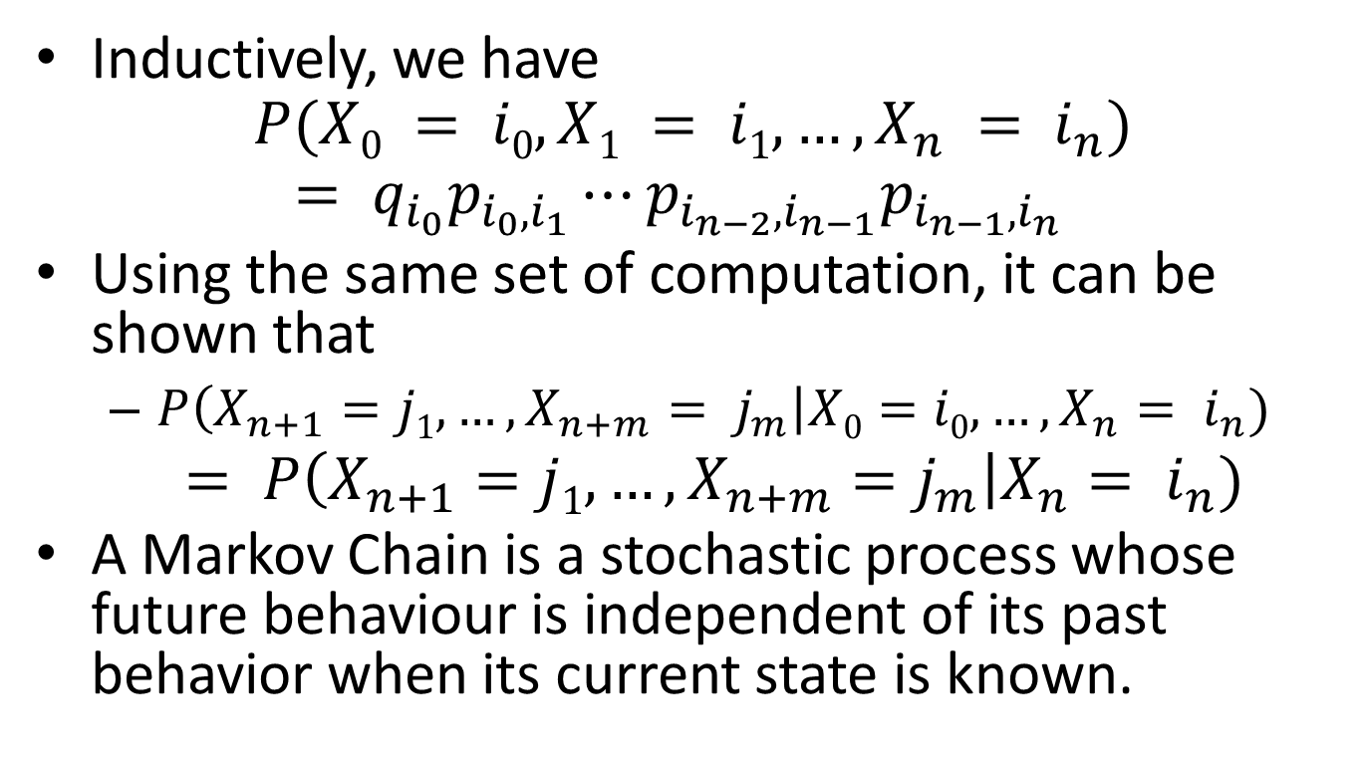
Characterising a Markov Chain
Inductively, we have
$$P(X0 = i0, X1 = i1, …, X_{n} = i_{n})$$
$$= q_{i_{0}}p_{i_{0},i_{1}}⋯p_{i_{n−2},i_{n−1}}p_{i_{n−1},i_{n}}$$
Using the same set of computation, it can be shown that
$P\left(X_{n+1}=j1, …, X_{n+m}= j_{m}\right|X0=i0,…, X_{n}= i_{n})$
$= P\left(X_{n+1}=j1, …, X_{n+m}=j_{m}\right|X_{n}= i_{n})$
A Markov Chain is a stochastic process whose future behaviour is independent of its past behavior when its current state is known.

Slide 9
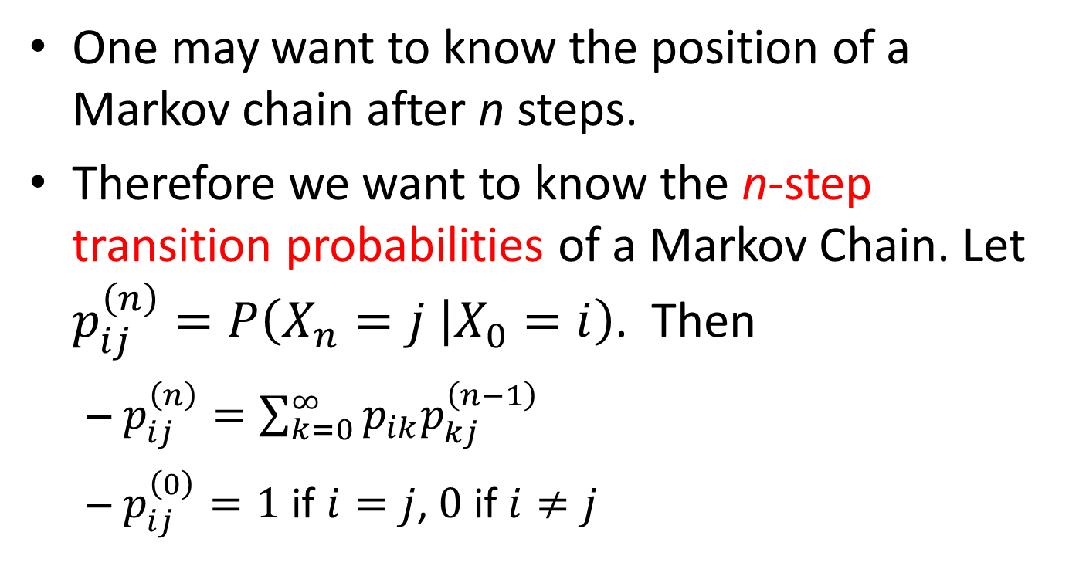
Chapman-Kolmogorov Equation
One may want to know the position of a Markov chain after n steps.
Therefore we want to know the n-step transition probabilities of a Markov Chain. Let $p_{ij}^{\left(n\right)}=P\left(X_{n}=j | X_{0}=i\right)$. Then
$p_{ij}^{\left(n\right)}=\sum_{k=0}^{∞}{p_{ik}p_{kj}^{\left(n−1\right)}}$
$p_{ij}^{\left(0\right)}=1$ if $i=j$, $0$ if $i≠j$

Slide 10
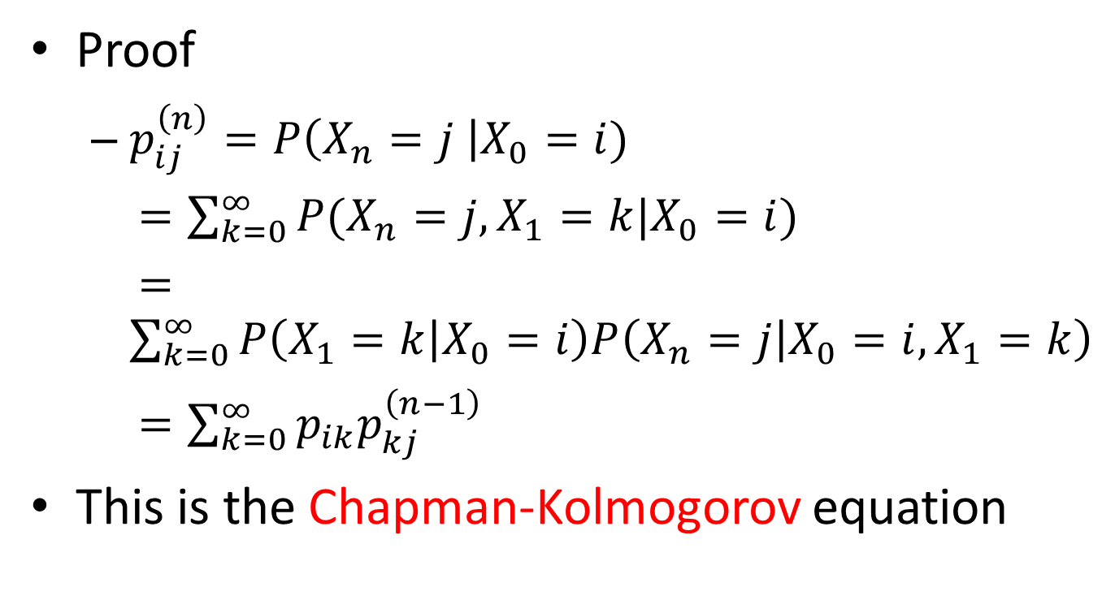
Chapman-Kolmogorov Equation
Proof
$p_{ij}^{\left(n\right)}=P\left(X_{n}=j \right|X_{0}=i)$
$=\sum_{k=0}^{∞}{P(X_{n}=j, X_{1}=k|X_{0}=i)}$
$=\sum_{k=0}^{∞}{P\left(X_{1}=k | X_{0}=i\right)P\left(X_{n}=j | X_{0}=i,X_{1}=k\right)}$
$=\sum_{k=0}^{∞}{p_{ik}p_{kj}^{\left(n−1\right)}}$
This is the Chapman-Kolmogorov equation

Slide 11
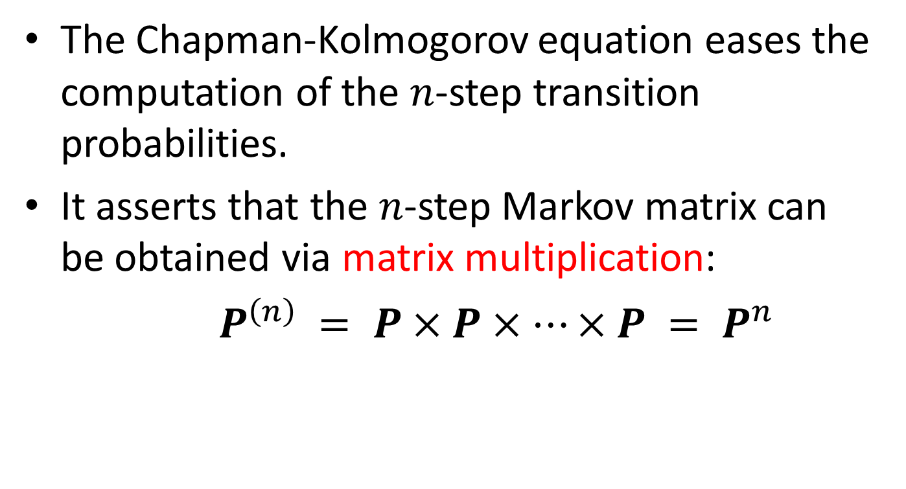
Matrix Operations
The Chapman-Kolmogorov equation eases the computation of the $n$-step transition probabilities.
It asserts that the $n$-step Markov matrix can be obtained via matrix multiplication:
$P^{\left(n\right)} = P×P×…×P = P^{n}$

Slide 12
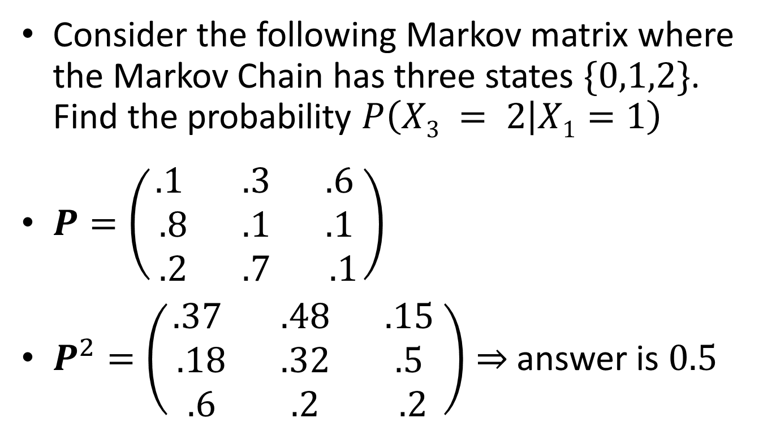
Example
Consider the following Markov matrix where the Markov Chain has three states $\{0,1,2\}$. Find the probability $P\left(X3 = 2 | X1=1\right)$
$P=\left(\begin{matrix}.1 & .3 & .6 \\ .8 & .1 & .1 \\ .2 & .7 & .1\end{matrix}\right)$
$P^{2}=\left(\begin{matrix}.37 & .48 & .15 \\ .18 & .32 & .5 \\ .6 & .2 & .2\end{matrix}\right)⇒$ answer is $0.5$

Slide 13
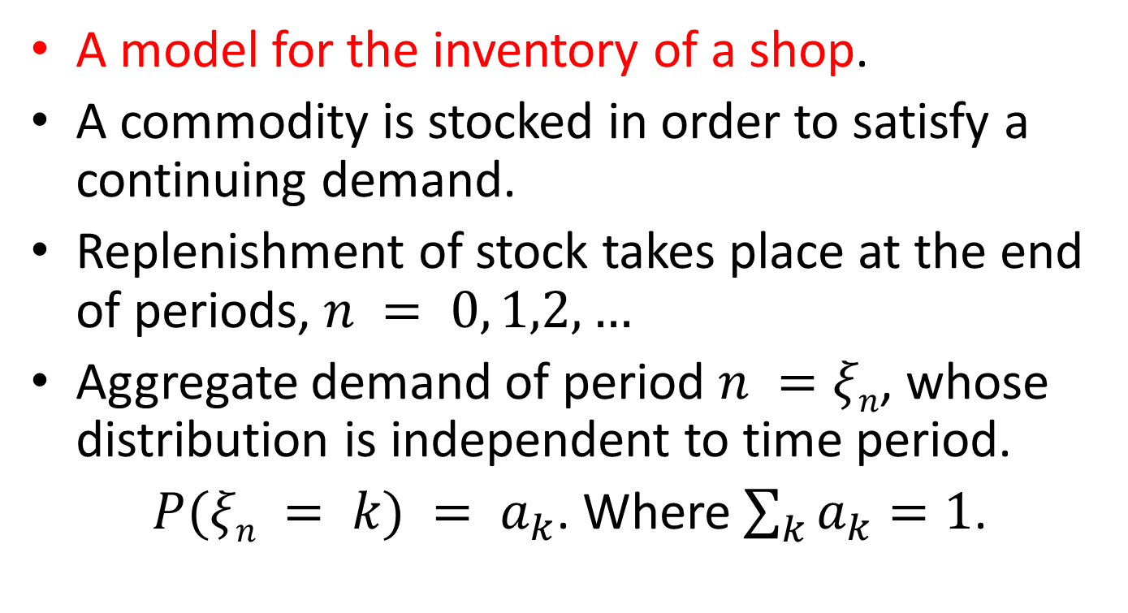
A Markov Model
A model for the inventory of a shop.
A commodity is stocked in order to satisfy a continuing demand.
Replenishment of stock takes place at the end of periods, $n = 0, 1,2,…$
Aggregate demand of period $n =ξn$, whose distribution is independent to time period.
$P(ξn = k) = a_{k}$. Where $\sum_{k}{a_{k}}=1$.

Slide 14
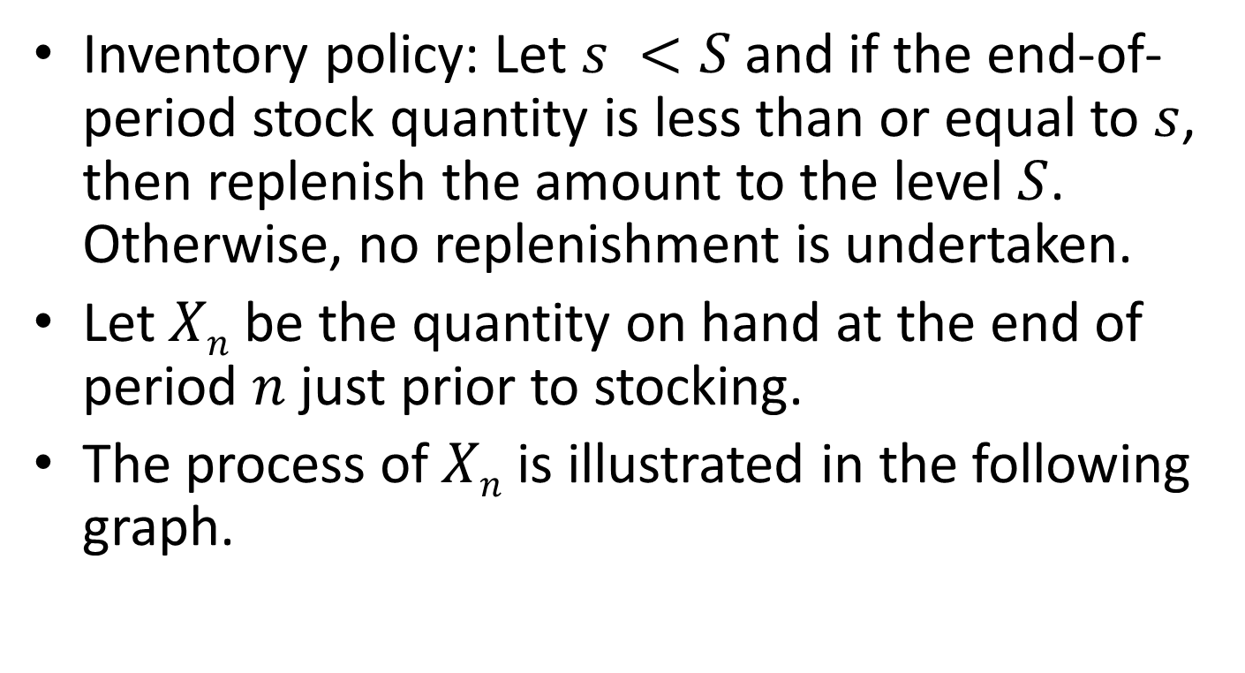
A Markov Model
Inventory policy: Let $s <S$and if the end-of-period stock quantity is less than or equal to $s$, then replenish the amount to the level $S$. Otherwise, no replenishment is undertaken.
Let $Xn$ be the quantity on hand at the end of period $n$ just prior to stocking.
The process of $Xn$ is illustrated in the following graph.

Slide 15






A Markov Model
$$S$$
ξ₂
$$X0$$
$$X2$$
ξ₁
ξ₃
$$X3$$
$$s$$
$$X1$$

Slide 16
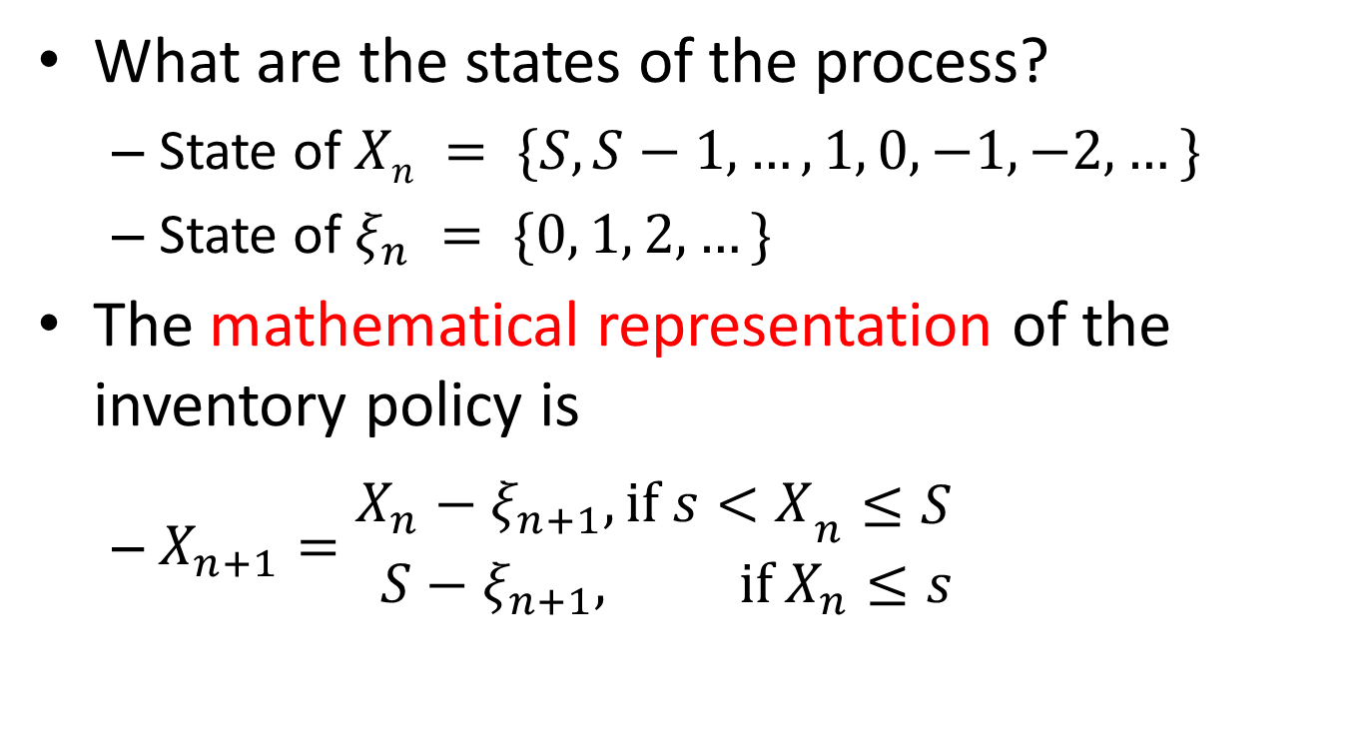
A Markov Model
What are the states of the process?
State of $Xn = \{S, S−1, …, 1, 0, −1, −2, …\}$
State of $ξ_{n} = \{0, 1, 2, …\}$
The mathematical representation of the inventory policy is
$X_{n+1}=\begin{matrix}{\begin{matrix}X_{n}−ξ_{n+1}, if s<X\end{matrix}}_{n}≤S \\ S−ξ_{n+1}, if X_{n}≤s\end{matrix}$

Slide 17
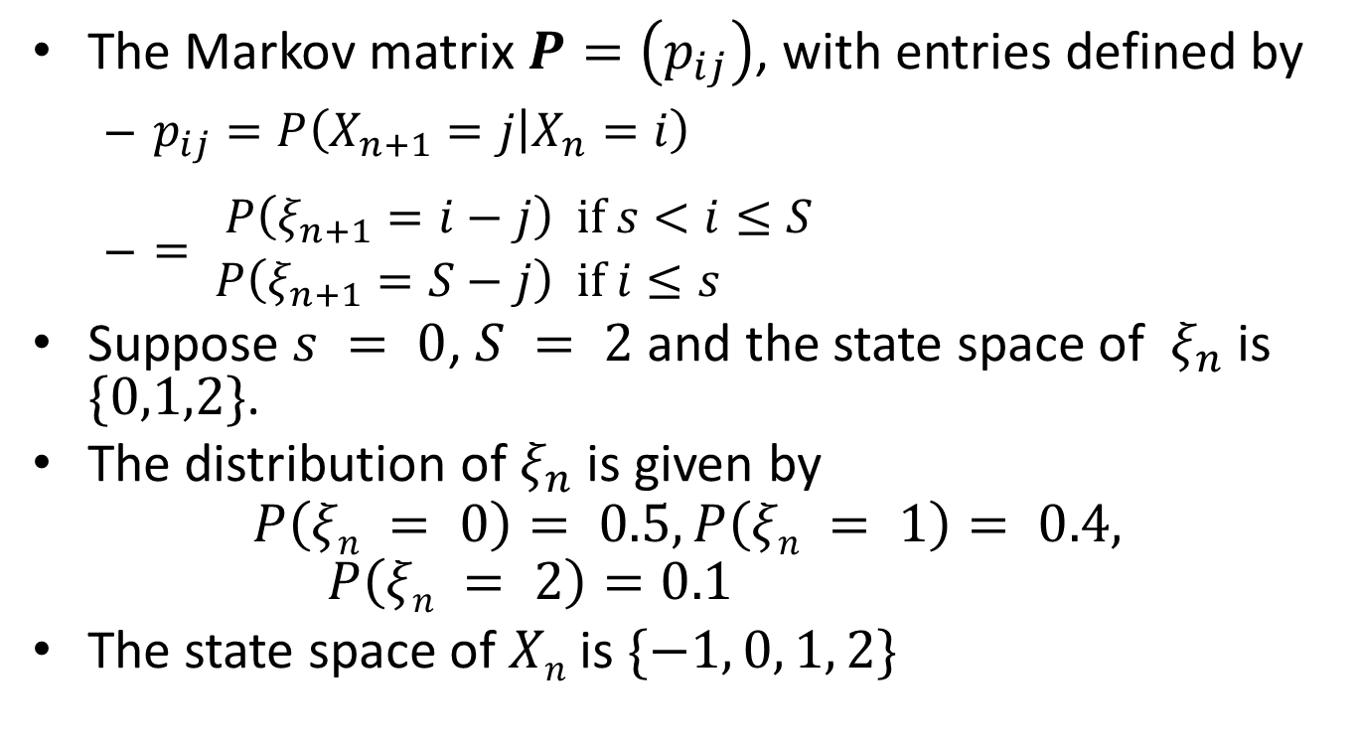
A Markov Model
The Markov matrix $P=\left(p_{ij}\right)$, with entries defined by
$p_{ij}=P\left(X_{n+1}=j | X_{n}=i\right)$
$=\begin{aligned}P\left(ξ_{n+1}=i−j\right) & if s<i≤S \\ P\left(ξ_{n+1}=S−j\right) & if i≤s\end{aligned}$
Suppose $s = 0$, $S = 2$and the state space of $ξ_{n}$ is $\{0,1,2\}$.
The distribution of $ξ_{n}$ is given by
$$P\left(ξn = 0\right)= 0.5, P\left(ξn = 1\right)= 0.4, P\left(ξn = 2\right)=0.1$$
The state space of $Xn$is$\{−1, 0, 1, 2\}$

Slide 18
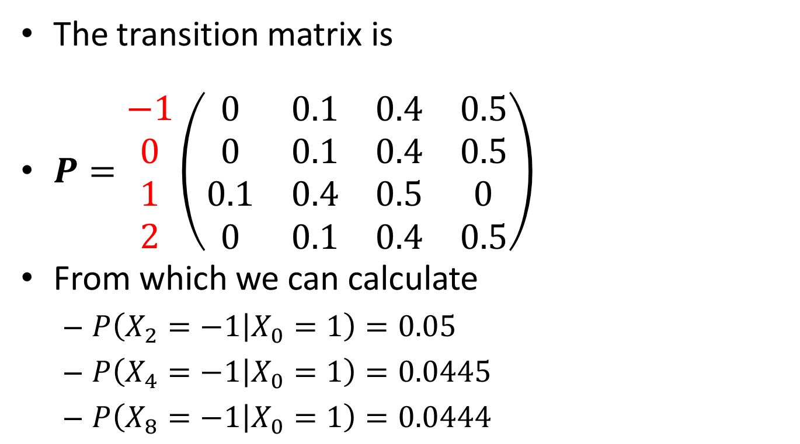
A Markov Model
The transition matrix is
$P=\begin{matrix}−1 \\ 0 \\ 1 \\ 2\end{matrix}\left(\begin{matrix}0 & 0.1 & 0.4 & 0.5 \\ 0 & 0.1 & 0.4 & 0.5 \\ 0.1 & 0.4 & 0.5 & 0 \\ 0 & 0.1 & 0.4 & 0.5\end{matrix}\right)$
From which we can calculate
$P\left(X_{2}=−1 | X_{0}=1\right)=0.05$
$P\left(X_{4}=−1 | X_{0}=1\right)=0.0445$
$P\left(X_{8}=−1 | X_{0}=1\right)=0.0444$

Slide 19
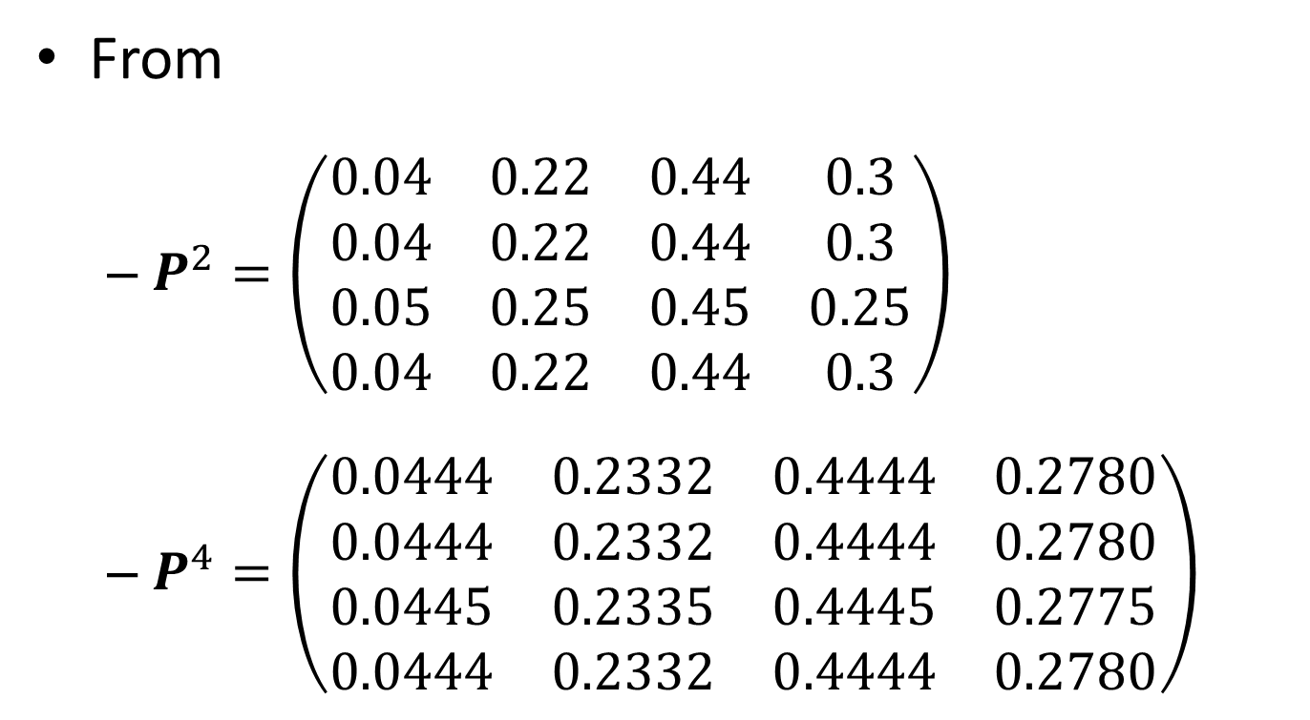
A Markov Model
From
$P^{2}=\left(\begin{matrix}0.04 & 0.22 & 0.44 & 0.3 \\ 0.04 & 0.22 & 0.44 & 0.3 \\ 0.05 & 0.25 & 0.45 & 0.25 \\ 0.04 & 0.22 & 0.44 & 0.3\end{matrix}\right)$
$P^{4}=\left(\begin{matrix}0.0444 & 0.2332 & 0.4444 & 0.2780 \\ 0.0444 & 0.2332 & 0.4444 & 0.2780 \\ 0.0445 & 0.2335 & 0.4445 & 0.2775 \\ 0.0444 & 0.2332 & 0.4444 & 0.2780\end{matrix}\right)$

Slide 20
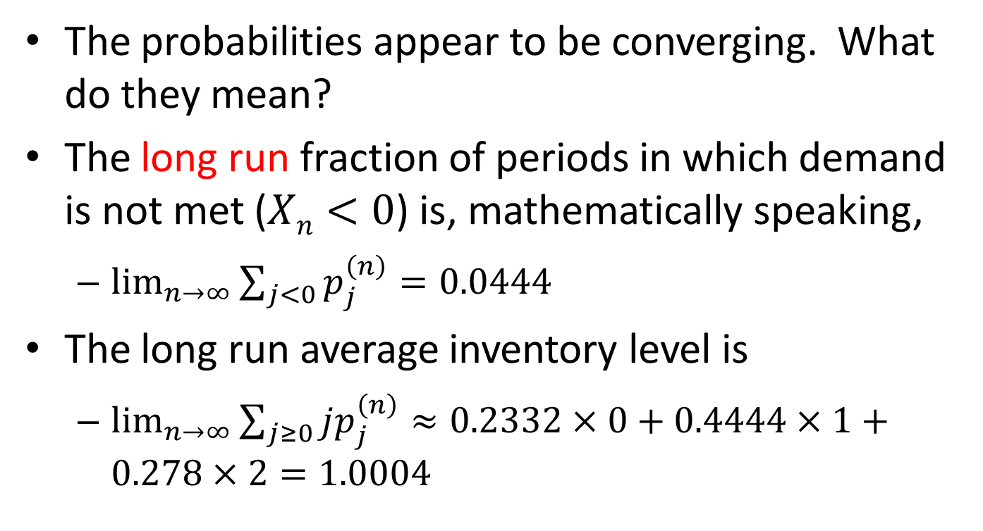
A Markov Model
The probabilities appear to be converging. What do they mean?
The long run fraction of periods in which demand is not met ($Xn<0$) is, mathematically speaking,
$\lim_{n→∞}{\sum_{j<0}{p_{j}^{\left(n\right)}}=0.0444}$
The long run average inventory level is
$\lim_{n→∞}{\sum_{j≥0}{jp_{j}^{\left(n\right)}}}≈0.2332×0+0.4444×1+0.278×2=1.0004$

Slide 21
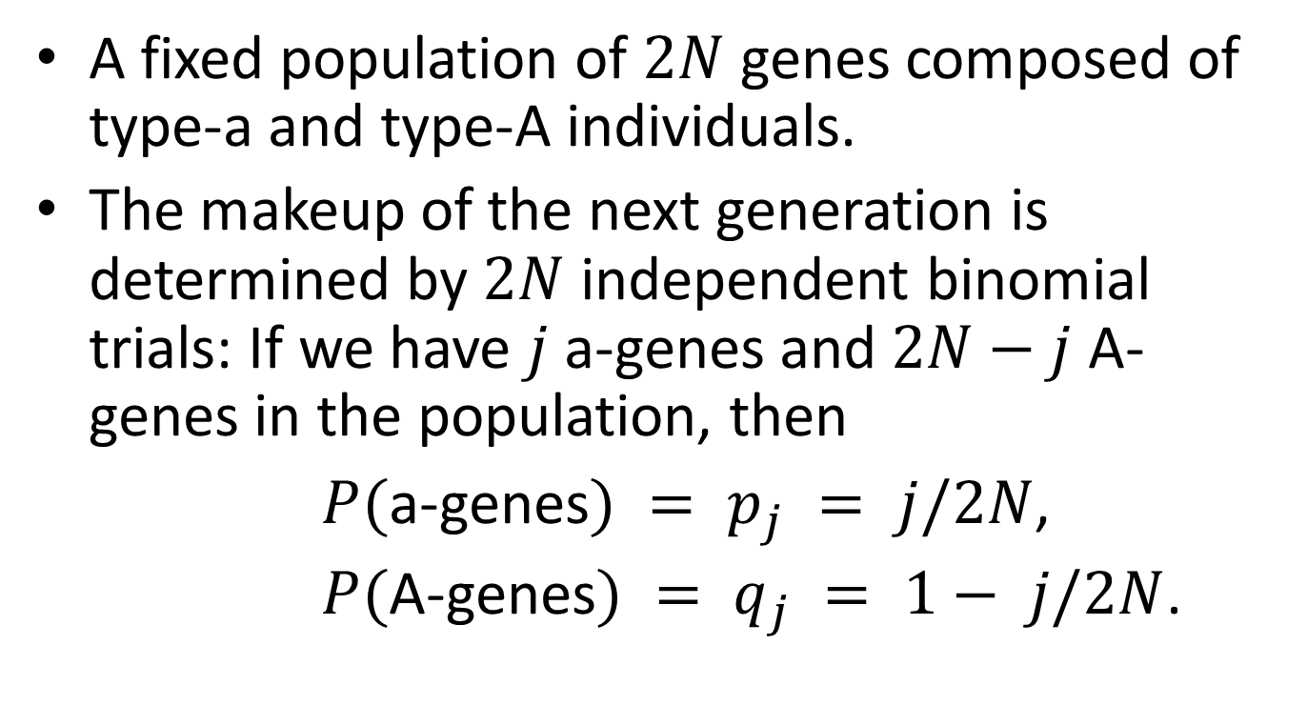
A Markov Chain for Genetics
A fixed population of $2N$ genes composed of type-a and type-A individuals.
The makeup of the next generation is determined by $2N$ independent binomial trials: If we have $j$ a-genes and $2N−j$ A-genes in the population, then
$P($a-genes$) = p_{j} = j/2N$,
$P($A-genes$) = q_{j} = 1− j/2N$.

Slide 22
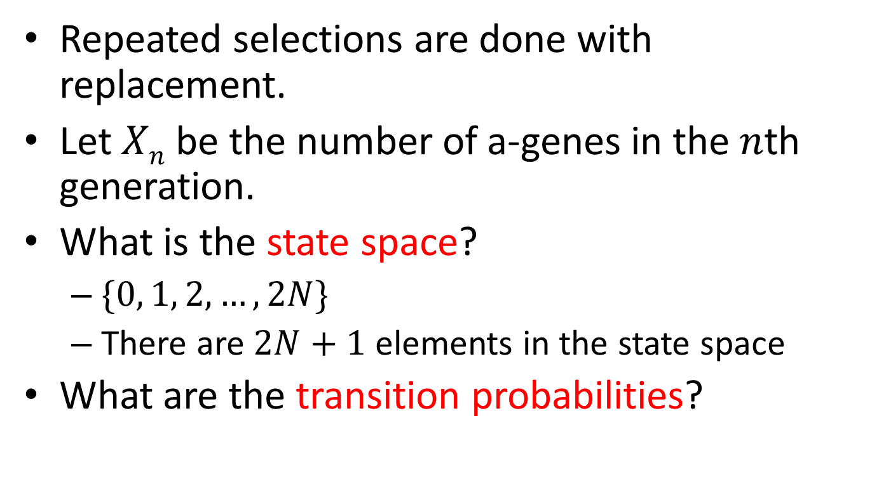
A Markov Chain for Genetics
Repeated selections are done with replacement.
Let $Xn$ be the number of a-genes in the $n$th generation.
What is the state space?
$\{0, 1, 2, …, 2N\}$
There are $2N+1$ elements in the state space
What are the transition probabilities?

Slide 23
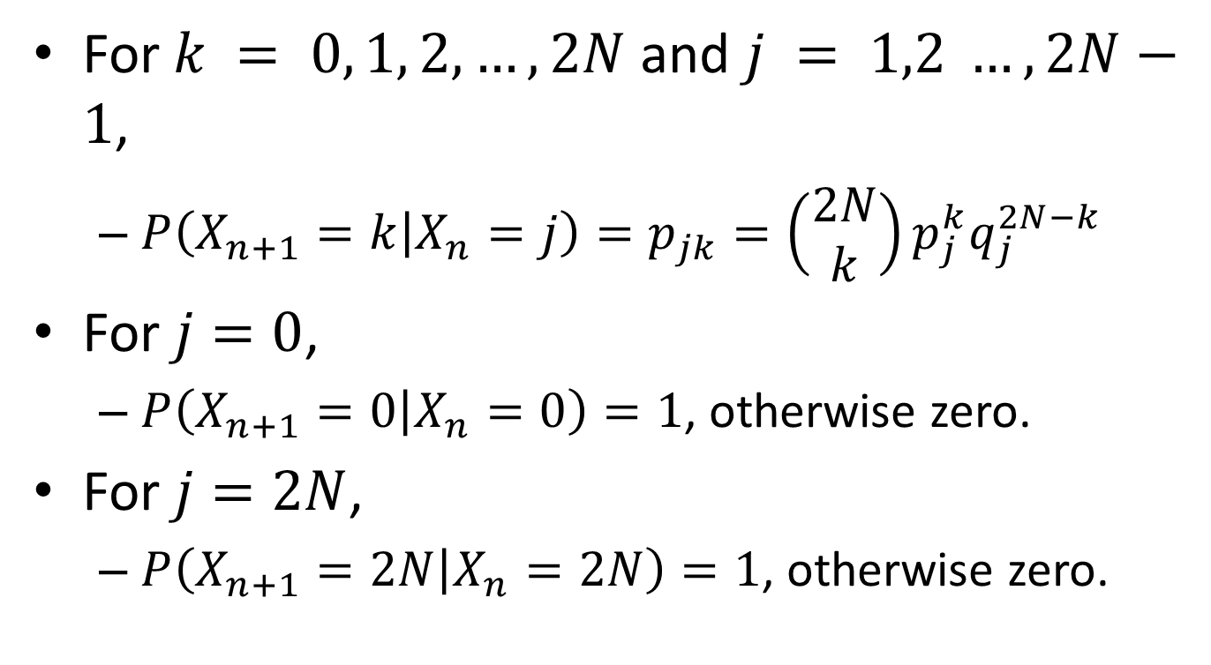
A Markov Chain for Genetics
For $k = 0, 1, 2, …, 2N$and $j = 1,2 …, 2N−1$,
$P\left(X_{n+1}=k | X_{n}=j\right)=p_{jk}=\left(\begin{matrix}2N \\ k\end{matrix}\right)p_{j}^{k}q_{j}^{2N−k}$
For $j=0$,
$P\left(X_{n+1}=0 | X_{n}=0\right)=1$, otherwise zero.
For $j=2N$,
$P\left(X_{n+1}=2N | X_{n}=2N\right)=1$, otherwise zero.

Slide 24
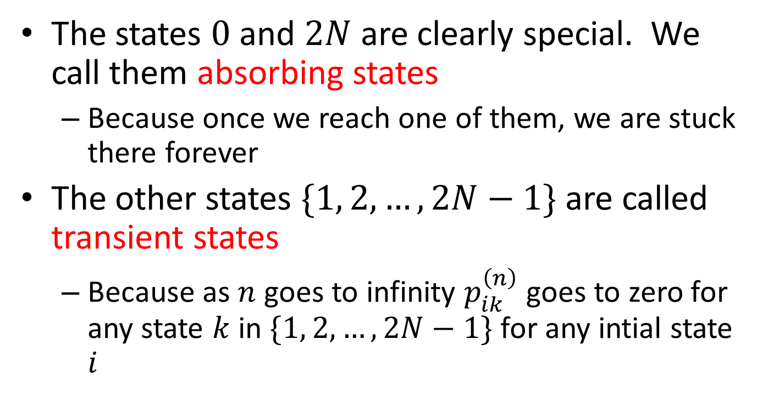
A Markov Chain for Genetics
The states $0$ and $2N$ are clearly special. We call them absorbing states
Because once we reach one of them, we are stuck there forever
The other states $\{1, 2, …,2N−1\}$ are called transient states
Because as $n$ goes to infinity $p_{ik}^{\left(n\right)}$ goes to zero for any state $k$ in $\{1, 2, …,2N−1\}$ for any intial state $i$

Slide 25
A Markov Chain for Bond Ratings
Rating Agencies are firms which are paid to provide forecasts of the behaviour of bonds issued by countries and companies
E.g. Moody’s, S&P, Fitch
When someone purchases company XYZ’s bond, they are essentially lending money to XYZ
Ratings are basically estimates of how likely it is XYZ will repay the loan

Slide 26
A Markov Chain for Bond Ratings
This is a one-year rating transition matrix, based on historical data from Moody’s from 1970 to 2013
(p 401, “Risk Management and Financial Institutions, 4th Ed.” by Hull)
Initial
Rating at year end
Rating
Aaa
Aa
A
Baa
Ba
B
Caa
Ca-C
Default
Aaa
90.65%
8.67%
0.65%
0.00%
0.03%
0.00%
0.00%
0.00%
0.00%
Aa
0.95%
89.44%
8.95%
0.54%
0.07%
0.02%
0.01%
0.00%
0.02%
A
0.06%
2.56%
90.73%
5.86%
0.58%
0.11%
0.03%
0.00%
0.06%
Baa
0.04%
0.18%
4.20%
90.27%
4.17%
0.78%
0.16%
0.02%
0.18%
Ba
0.01%
0.06%
0.37%
6.17%
83.45%
8.06%
0.65%
0.07%
1.16%
B
0.01%
0.03%
0.12%
0.34%
5.08%
82.90%
6.69%
0.65%
4.18%
Caa
0.00%
0.02%
0.02%
0.12%
0.42%
9.74%
71.07%
4.06%
14.55%
Ca-C
0.00%
0.00%
0.07%
0.00%
0.43%
2.37%
10.59%
42.36%
44.20%
Default
0.00%
0.00%
0.00%
0.00%
0.00%
0.00%
0.00%
0.00%
100.00%

Slide 27
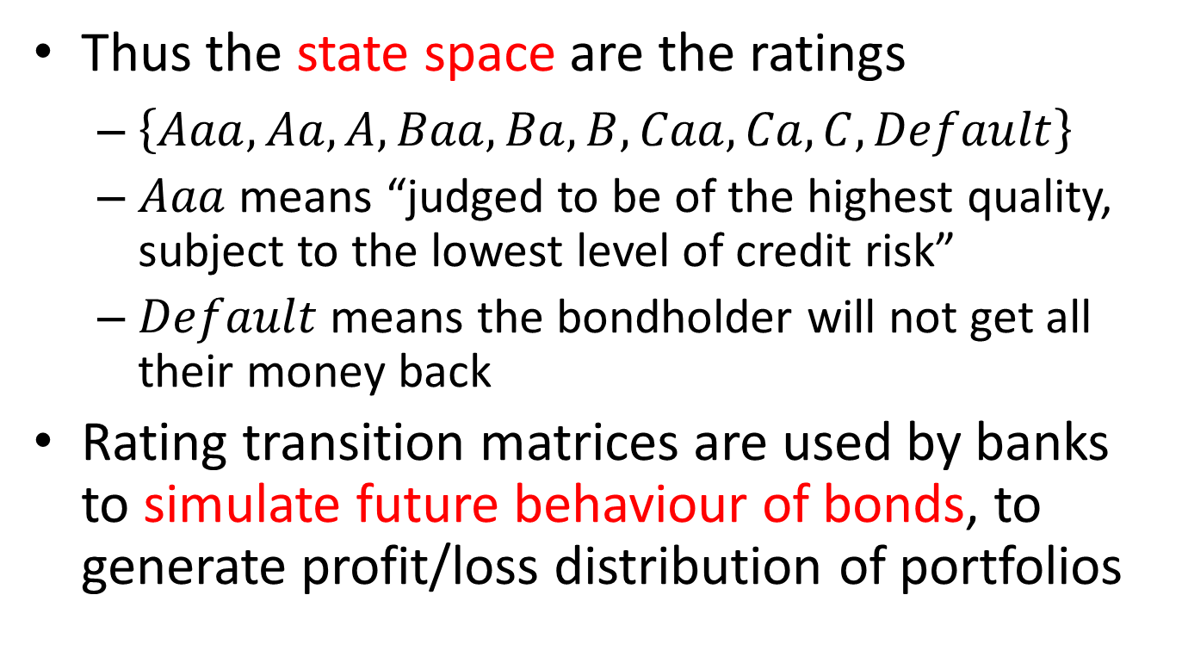
A Markov Chain for Bond Ratings
Thus the state space are the ratings
$\left\{Aaa, Aa, A, Baa, Ba, B, Caa, Ca, C, Default\right\}$
$Aaa$ means “judged to be of the highest quality, subject to the lowest level of credit risk”
$Default$ means the bondholder will not get all their money back
Rating transition matrices are used by banks to simulate future behaviour of bonds, to generate profit/loss distribution of portfolios

Slide 28
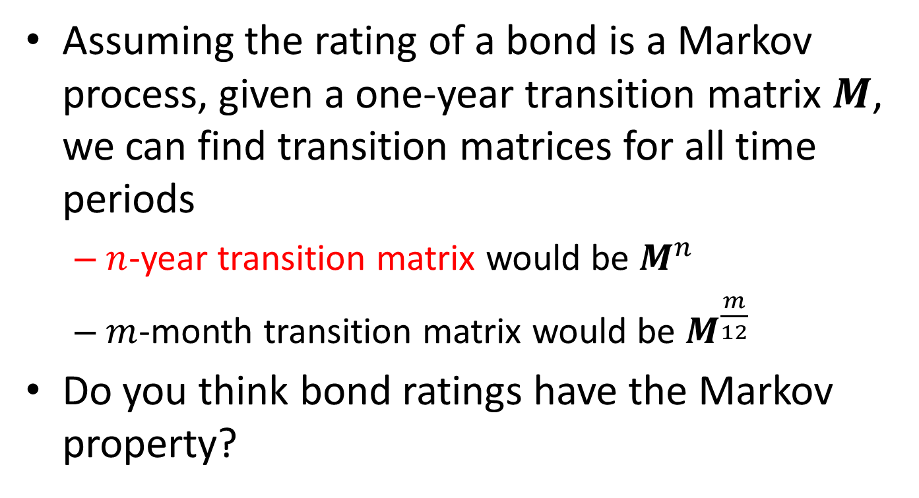
A Markov Chain for Bond Ratings
Assuming the rating of a bond is a Markov process, given a one-year transition matrix $M$, we can find transition matrices for all time periods
$n$-year transition matrix would be $M^{n}$
$m$-month transition matrix would be $M^{\frac{m}{12}}$
Do you think bond ratings have the Markov property?

